Slide 1
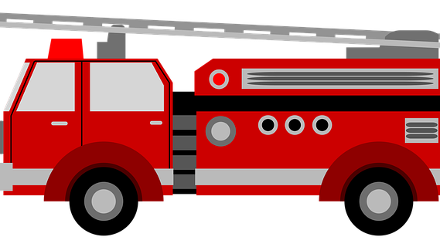
Stop, Drop, Cover and Roll
Mrs. Kelsey Johnson, Pub. Ed.

Slide 2
Hot things burn
Red means STOP

Slide 3
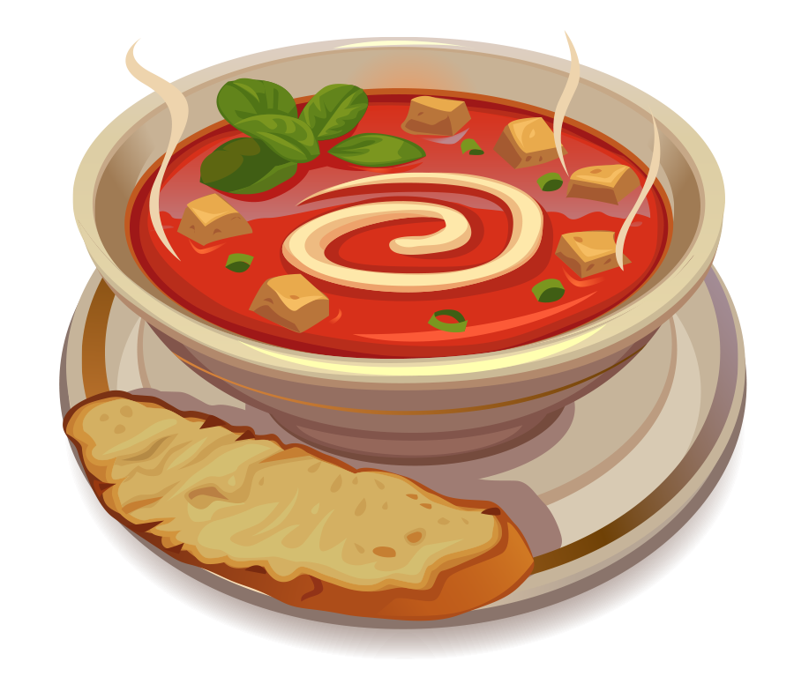
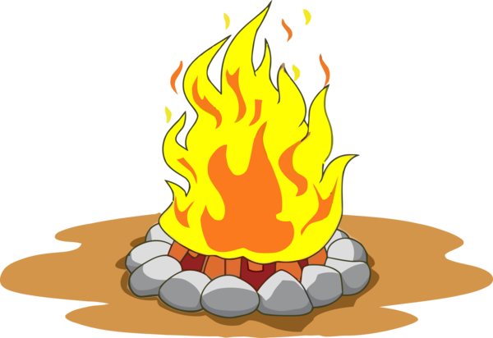
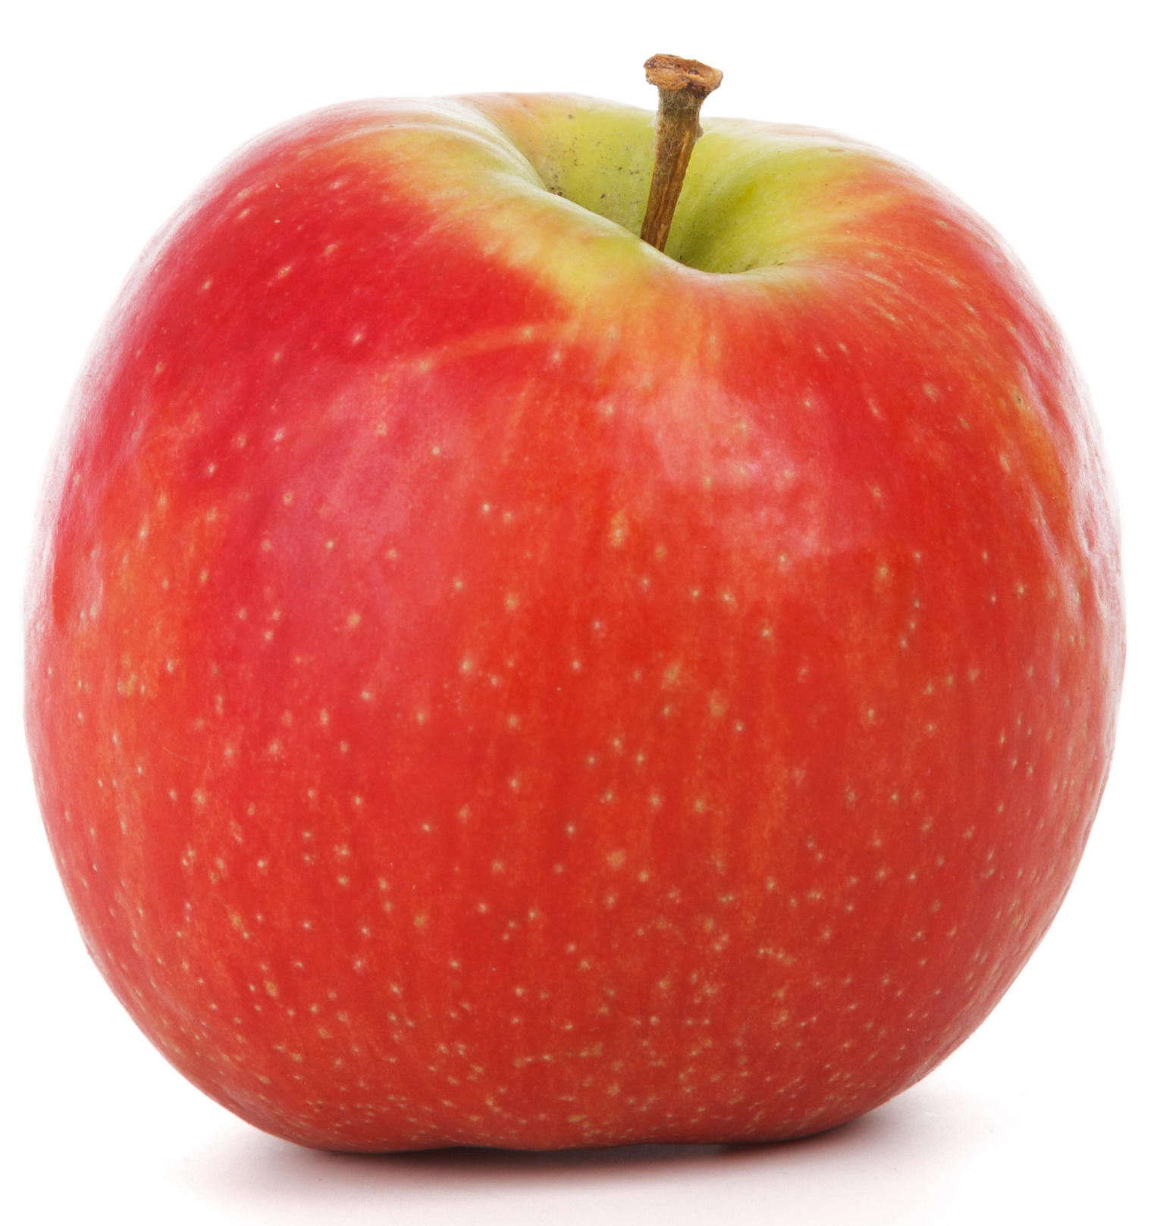
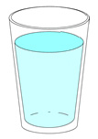
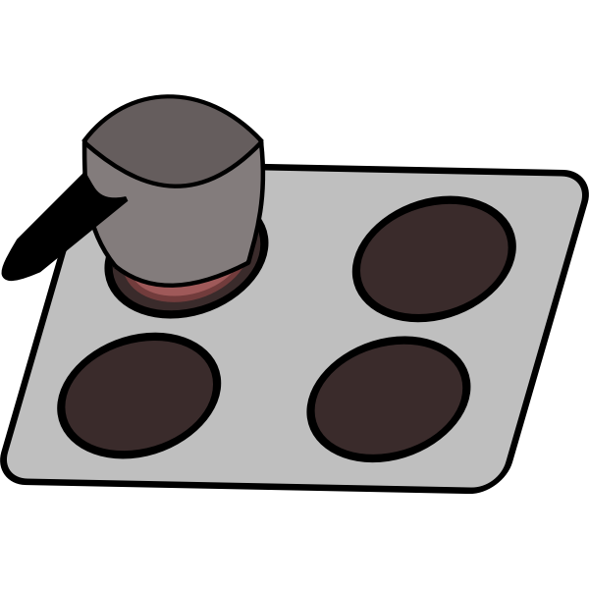
Hot or not hot
HOT NOT HOT

Slide 4
If my clothes catch fire.....

Slide 5
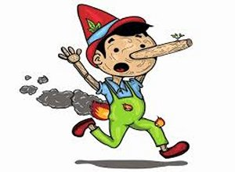
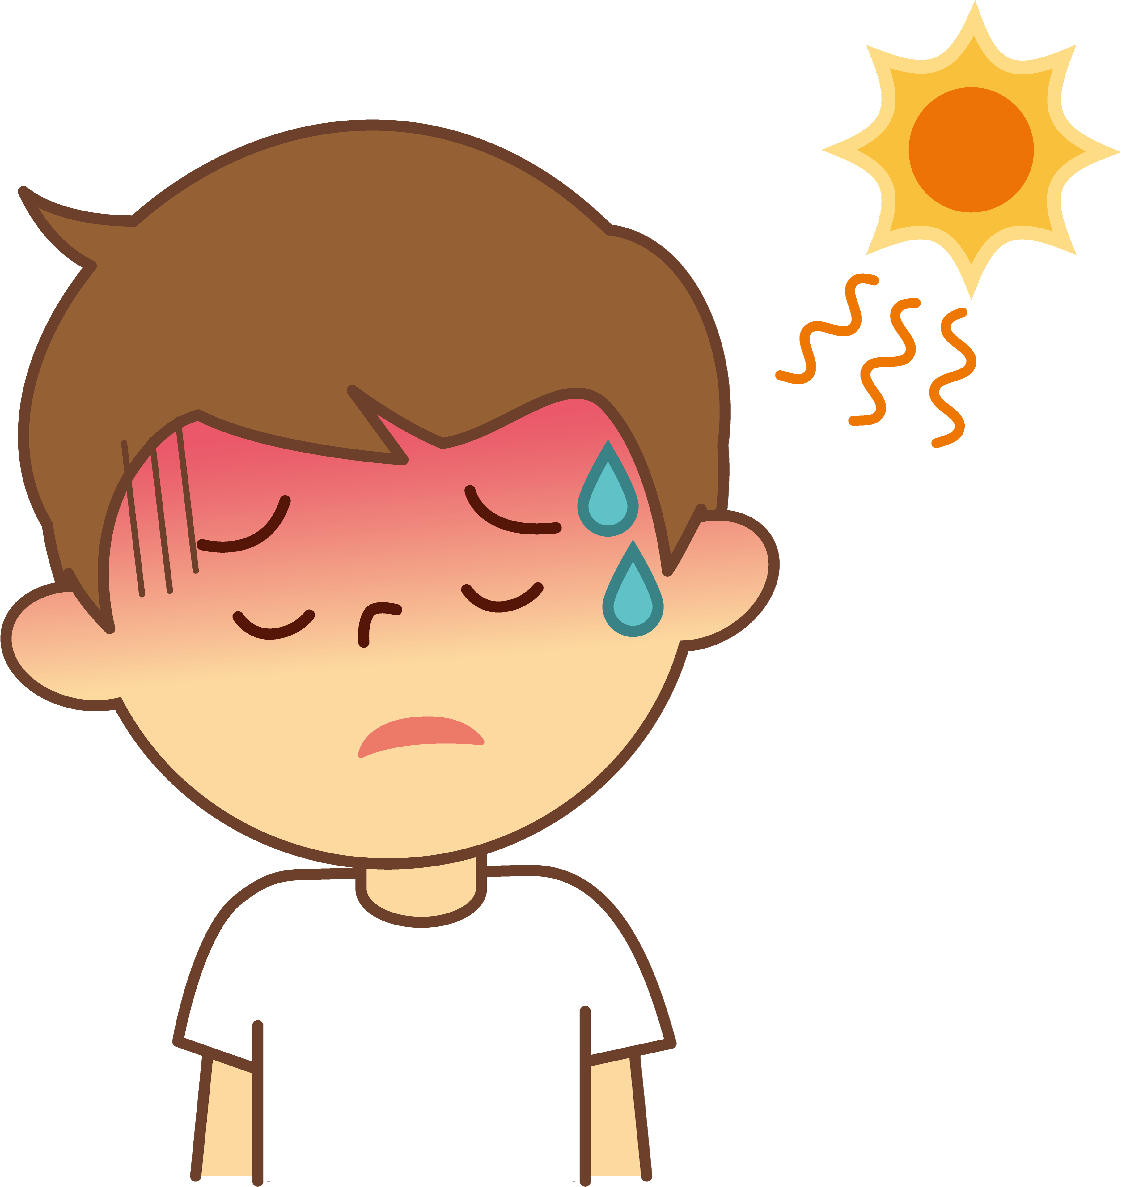
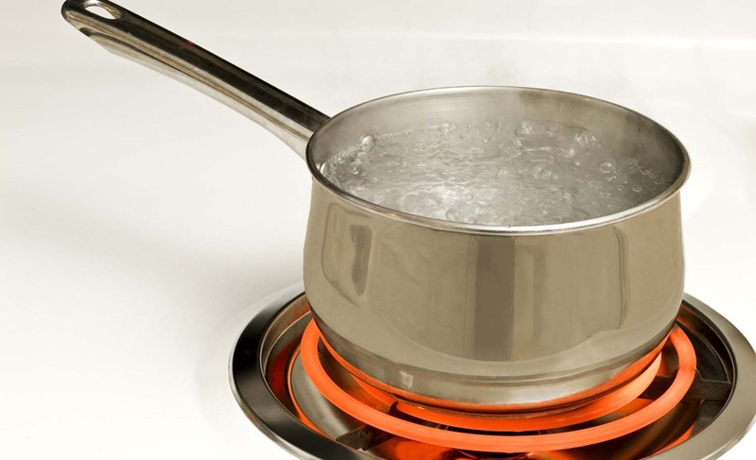
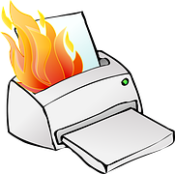
Do I need to stop, drop, and roll?
YES NO

Slide 6
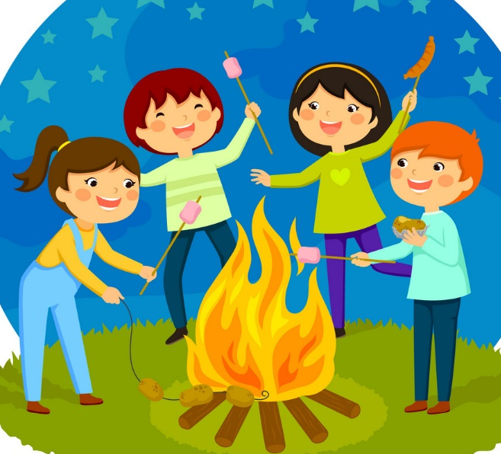
GAME TIME

Slide 7
Let’s Color and build our fire trucks!

